Slide 1
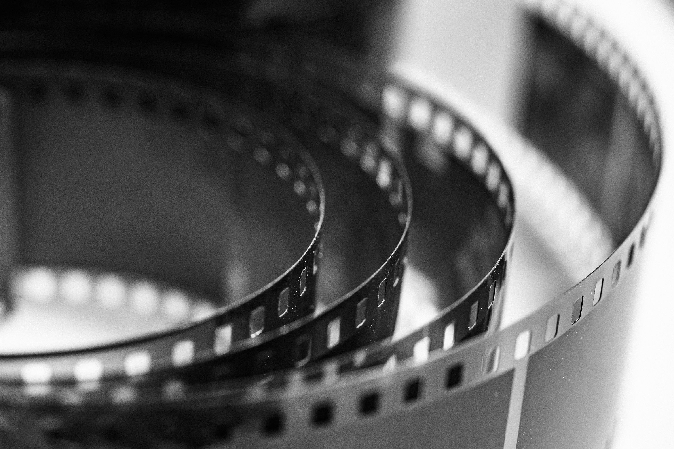

EZ TechMovie
“Where we movies comes to you”
Christopher Carson
Chad Grismore
Victor Ledezma
Travis Simmons
INT499: Information Technology Capstone Project
John Russell
Gantt Chart and Wireframes
25 May 2025

Slide 2

Gnatt chart Breakdown
1. Project Setup
(Days 1–2)
Initial planning and environment setup.
2. Design Phase
(Days 3–7)
UI/UX Design.
Backend setup begins concurrently.
3. Core Features Development
(Days 8–15)
User Registration & Login.
Personalized Watchlists.
Movie Search & Browse
4. Advanced Features & Integration
(Days 15–19)
Social Features.
Parental Controls.
Streaming Integration
AI-driven Recommendations

Slide 3

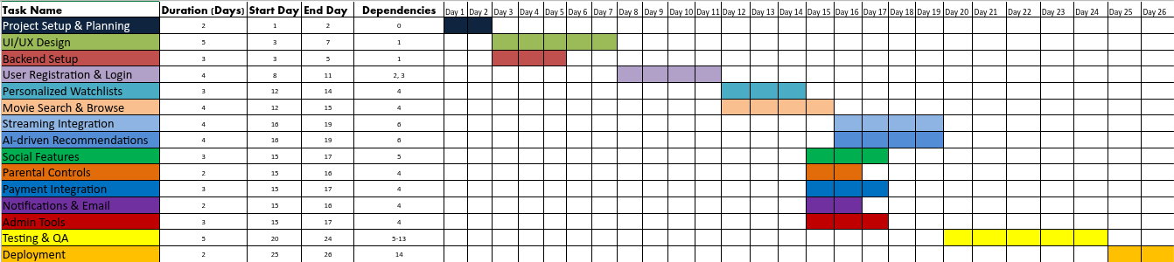
Gantt CHart & Key Dependencies
EZTechMovie
UI/UX Design is a prerequisite for most user-facing features.
Backend Setup must be completed before Login and Watchlist features.
Social Features and Parental Controls depend on prior core feature implementation.

Slide 4
WireFrame Breakdown
Login Page
Home Page
Search Page
Secure user
authentication.
Central hub for user interaction.
Help users quickly find movies by title, genre, or keyword.
Cart Page
Profile Page
View and manage selected movies before streaming or purchasing.
Displays user's watchlist and preferences.

Slide 5




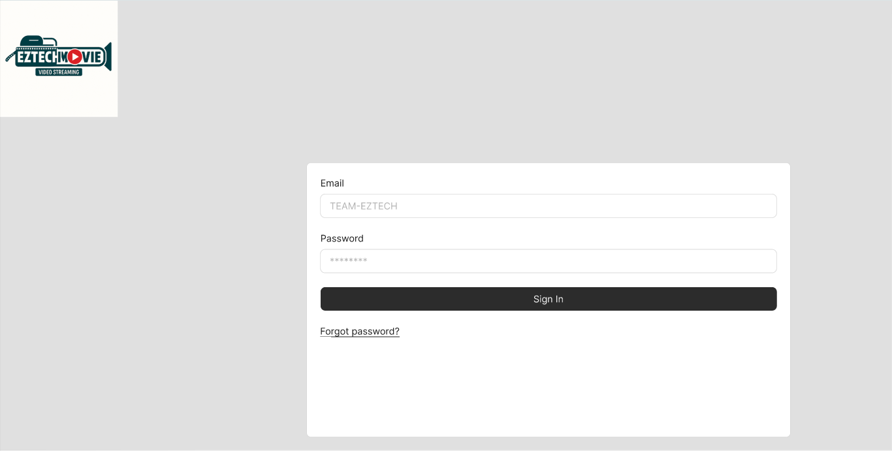
Wireframe
EZTECH MOVIE

Slide 6
Thank you!
Thank you from the #1 EZTechMoive Team

